Slide 1


Cornelius Enetomhe
11th July 2024

Slide 2

Outline
Executive Summary
Introduction
Methodology
Results
Conclusion
Appendix

Slide 3
Executive Summary
Summary of methodologies
Data Collection through API
Data Collection with Web Scraping
Data Wrangling
Exploratory Data Analysis with SQL
Exploratory Data Analysis with Data Visualization
Interactive Visual Analytics with Folium
Machine Learning Prediction
Summary of all results
Exploratory Data Analysis result
Interactive analytics in screenshots
Predictive Analytics result

Slide 4
Introduction
Project background and context
Space X advertises Falcon 9 rocket launches on its website with a cost of 62 million dollars; other providers cost upward of 165 million dollars each, much of the savings is because Space X can reuse the first stage. Therefore, if we can determine if the first stage will land, we can determine the cost of a launch. This information can be used if an alternate company wants to bid against space X for a rocket launch. This goal of the project is to predict with the aid of machine learning pipeline if the first stage will land successfully.
Problems you want to find answers
What factors determine if the rocket will land successfully?
The relationship amongst various features that determine the success rate of a successful landing.
What conditions ensures a successful landing.

Slide 5


Slide 6
Methodology
Executive Summary
Data collection methodology:
With Rest API and Web scraping .
Perform data wrangling
One-hot encoding was applied to categorical features
Perform exploratory data analysis (EDA) using visualization and SQL
Perform interactive visual analytics using Folium and Plotly Dash
Perform predictive analysis using classification models
Different models were built and evaluated to get best classifier

Slide 7
Data Collection
The data sets were collected from:
An IBM copy of a call to the publically accessible SpaceX API with launch data in JSON format.
A permanently linked Wikipedia page with launch data in HTML tables .
Further data sets were provided. See darker green .csv files in top row of diagram below.

Slide 8
Data Collection – SpaceX API
Flowchart of SpaceX API Calls
We used the get request to the SpaceX API to collect data and placed it into a Pandas dataframe for further analysis
The GitHub link to the notebook is https://github.com/jamesenet/SpaceX-Falcon-9-first-stage-Landing-Prediction/blob/main/spacex-data-collection-api.ipynb
Place call to API
Extract nested data and convert date format
Use defined functions to generate specific columns of data
Combine separate columns into a DataFrame
Filter out all launches with rockets other than the Falcon 9
Handle missing values

Slide 9
Data Collection - Scraping
Flowchart of SpaceX Web Scraping
We applied web scraping to webscrap Falcon 9 launch records with BeautifulSoup from a Wikipedia page.
We parsed the table and converted it into a pandas dataframe for further analysis.
The GitHub link to the notebook is https://github.com/jamesenet/SpaceX-Falcon-9-first-stage-Landing-Prediction/blob/main/SpaceXwebscraping.ipynb
Web Scrape the page to get the HTML text
Create a BeautifulSoup object from the response text content
Find the tables
From the launch table, extract the column names from the <th></th> tags
Create DataFrame by parsing the launch tables

Slide 10
Data Wrangling
Flowchart of SpaceX Data Wrangling
We loaded the .csv files from earlier sections and cleaned them.
We calculated the number of launches at each site, and the number and occurrence of each orbits
The handful of mission outcome types were converted to a binary classification where 1 means that the Falcon 9 first stage landing was a success and 0 means that it was a failure.
Added the classification to the dataframe.
The GitHub link to the notebook is https://github.com/jamesenet/SpaceX-Falcon-9-first-stage-Landing-Prediction/blob/main/spacex-Data%20wrangling.ipynb
Load .csv data from earlier section
Find the number of launches at each site
Find the number of each type of orbit
Find the number of each type of mission outcome
Create a DataFrame column from the outcome data
Compile everything into a DataFrame

Slide 11
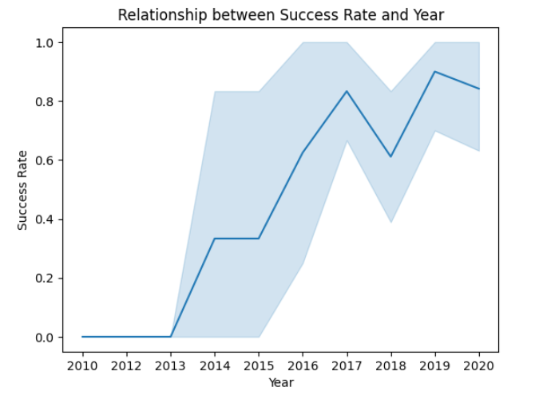
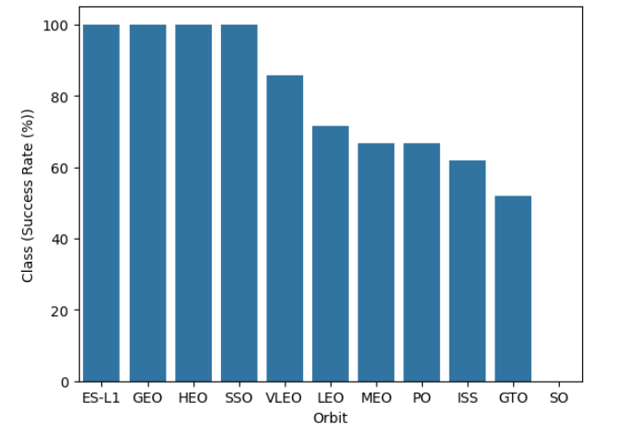
EDA with Data Visualization
We explored the data by visualizing the relationship between flight number and launch Site, payload and launch site, success rate of each orbit type, flight number and orbit type, the launch success yearly trend.
The GitHub link to the notebook is https://github.com/jamesenet/SpaceX-Falcon-9-first-stage-Landing-Prediction/blob/main/SpaceX%20Exploratory%20Analysis.ipynb

Slide 12
EDA with SQL
We applied EDA with SQL to get insight from the data. We wrote queries to find out for instance:
The names of unique launch sites in the space mission.
The total payload mass carried by boosters launched by NASA (CRS)
The average payload mass carried by booster version F9 v1.1
The total number of successful and failure mission outcomes
The failed landing outcomes in drone ship, their booster version and launch site names.
Rank the count of landing outcomes between the date 2010-06-04 and 2017-03-20
The GitHub link to the notebook is
https://github.com/jamesenet/SpaceX-Falcon-9-first-stage-Landing-Prediction/blob/main/eda-sql-coursera_sqllite.ipynb

Slide 13
Build an Interactive Map with Folium
Summarize what map objects such as markers, circles, lines, etc. you created and added to a folium map
Markers were added for launch sites and for the NASA Johnson Space Center
Circles were added for the launch sites.
Lines were added to show the distance to the nearby features
Distance from CCAFS LC-40 to the coastline
Distance from CCAFS LC-40 to the rail line
Distance from CCAFS LC-40 to the perimeter road
The GitHub link to the notebook is
https://github.com/jamesenet/SpaceX-Falcon-9-first-stage-Landing-Prediction/blob/main/SpaceX_launch_site_location.ipynb

Slide 14
Build a Dashboard with Plotly Dash
The input dropdown is used to select one or all launch sites for the pie chart and scatterplot.
The pie chart displays one of two things:
For All Sites –the distribution of successful Falcon 9 first stage landings between the sites
For One Site –the distribution of successful and failed Falcon 9 first stage landings for that site
The input slider is used to filter the payload masses for the scatterplot.
The scatterplot displays the distribution of Falcon 9 first stage landings split by payload mass, mission outcome and by booster version category

Slide 15
Predictive Analysis (Classification)
The dataset was split into training and testing sets.
Logistic Regression, SVM (Support Vector Machine), Decision Tree, and KNN (k-Nearest Neighbors) machine learning models were trained on the training data set.
Hyper-parameters were evaluated using GridSearchCV() and the best was selected using ‘.best_params_’.
Using the best hyper-parameters, each of the four models were scored on accuracy by using the testing data set.
The GitHub link to the notebook is
https://github.com/jamesenet/SpaceX-Falcon-9-first-stage-Landing-Prediction/blob/main/SpaceX_Machine%20Learning%20Prediction_Part_5.ipynb
DataFrame was created with the cleaned data
The data was split into training and testing sets
Each of four models were trained using the training data set
Each of four models were evaluated using the testing data set
Models were compared and rated based on accuracy scores

Slide 16
Results
Exploratory data analysis results
Interactive analytics demo in screenshots
Predictive analysis results

Slide 17


Slide 18
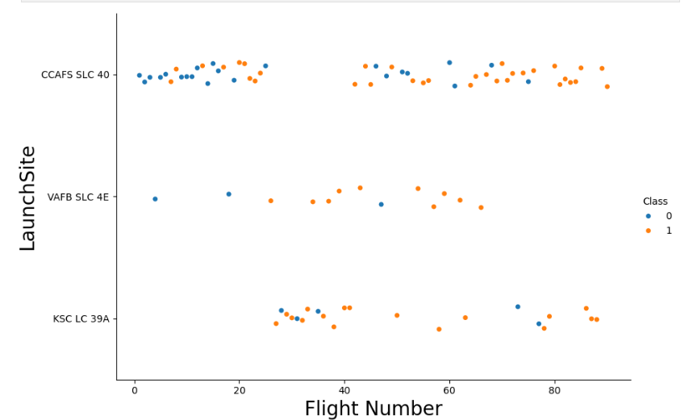
Flight Number vs. Launch Site
Successful Falcon 9 first stage landings appear to become more prevalent as the flight number increases in each launch site.

Slide 19
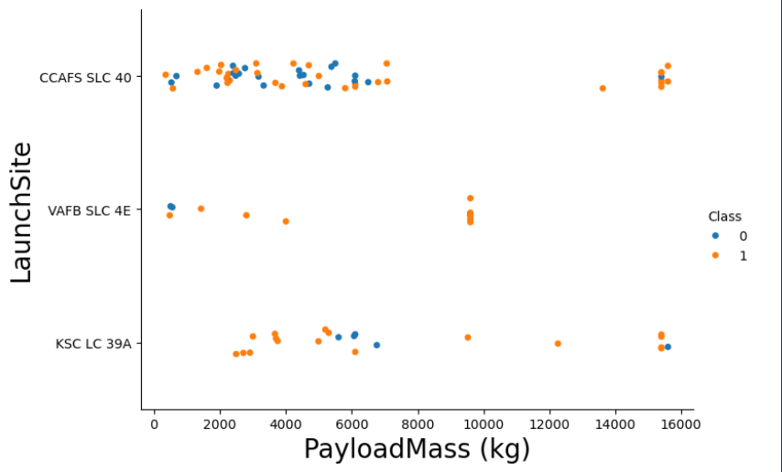
Payload Vs. Launch Site
For the CCAFS SLC 40 launch site, the payload mass and the landing outcome appear to not be strongly correlated.
The failed landings at the KSC LC 39A launch site are all grouped around a narrow band of payload masses.

Slide 20
Success Rate vs. Orbit Type
ES-L1, SSO, HEO and GEO orbits have no failed first stage landings.
SO orbits have no successful first stage landings.

Slide 21
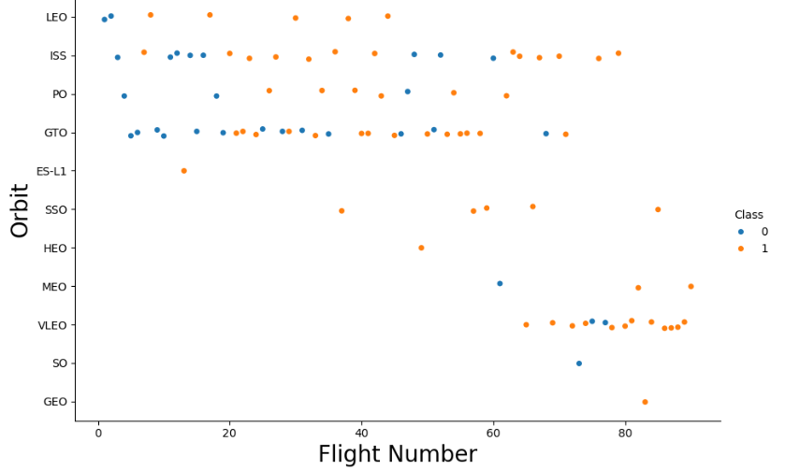
Flight Number vs. Orbit Type
There is a correlation between flight number and success rate with larger flight numbers being associated with higher success rates.
Although we observe that in the GTO orbit, there is no relationship between flight number and the orbit.

Slide 22
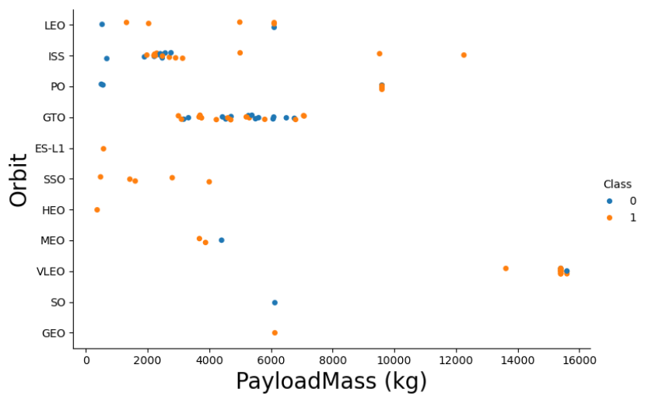
Payload vs. Orbit Type
We can observe that with heavy payloads, the successful landing are more for PO, LEO and ISS orbits.
Success rate appears to have no obvious correlation with payload mass as some have better success rates than others.

Slide 23
Launch Success Yearly Trend
We can observe that success rate since 2013 has been on the increase

Slide 24
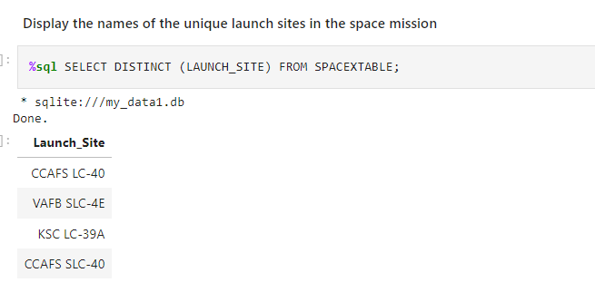
All Launch Site Names
We used the key word DISTINCT to show only unique launch sites from the SpaceX data.
There are four launch sites

Slide 25
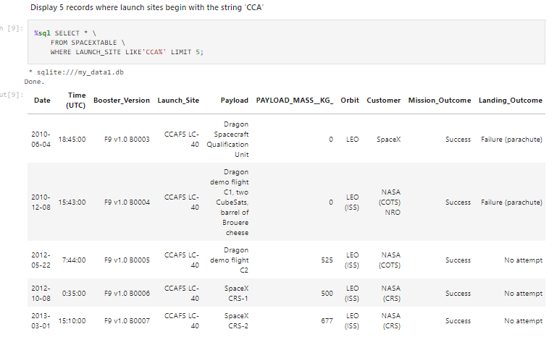
Launch Site Names Begin with 'CCA'
We used the query to display 5 records where launch sites begin with `CCA`

Slide 26
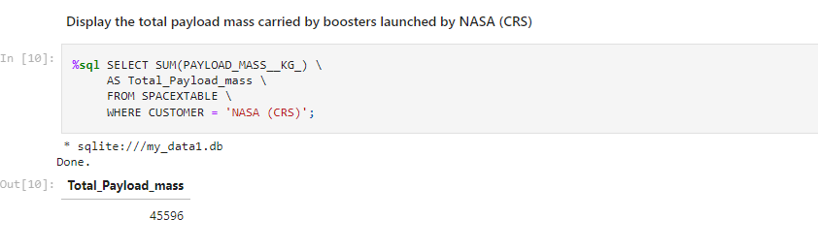
Total Payload Mass
We calculated the total payload carried by boosters from NASA as 45596 using the query below

Slide 27
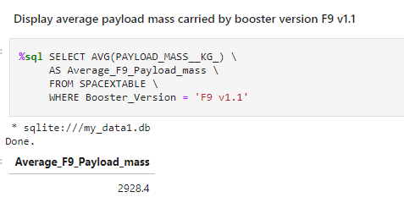
Average Payload Mass by F9 v1.1
We calculated the average payload mass carried by booster version F9 v1.1 as 2928.4

Slide 28
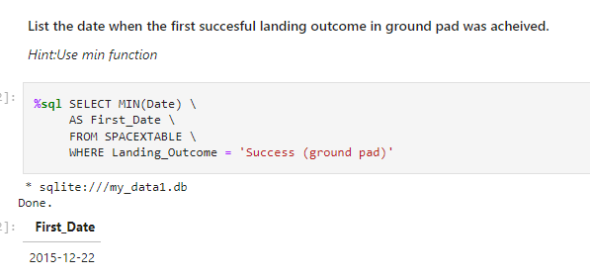
First Successful Ground Landing Date
We observed that the dates of the first successful landing outcome on ground pad was 22nd December 2015

Slide 29
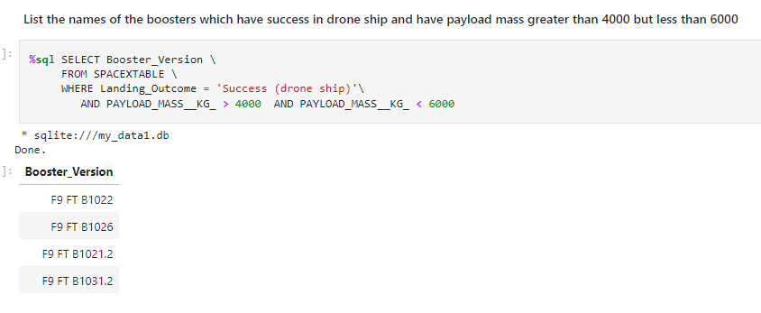
Successful Drone Ship Landing with Payload between 4000 and 6000
We used the WHERE clause to filter for boosters which have successfully landed on drone ship and applied the AND condition to determine successful landing with payload mass greater than 4000 but less than 6000

Slide 30
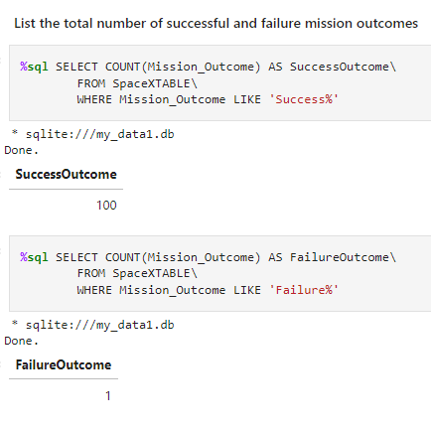
Total Number of Successful and Failure Mission Outcomes
We used wildcard like ‘%’ to filter for WHERE MissionOutcome was a success or a failure.

Slide 31
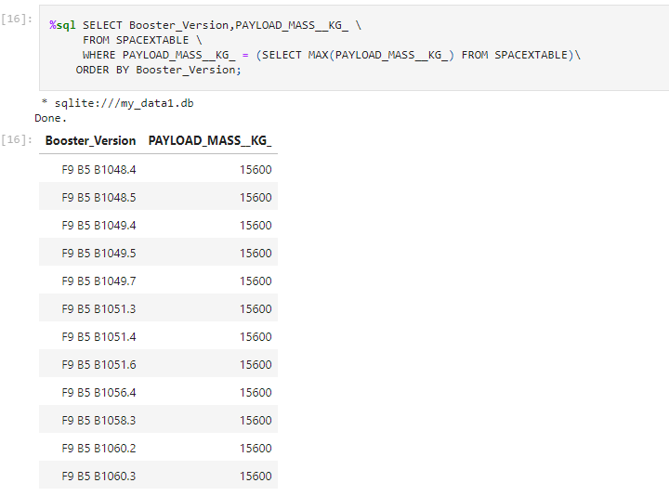
Boosters Carried Maximum Payload
We determined the booster that have carried the maximum payload using a subquery in the WHERE clause and the MAX() function.
The maximum payload mass carried in this dataset is 15,600 kg. Twelve (12) separate Falcon 9 boosters carried this amount of payload mass.

Slide 32

2015 Launch Records
We used a combinations of the WHERE clause, LIKE, AND, and BETWEEN conditions to filter for failed landing outcomes in drone ship, their booster versions, and launch site names for year 2015
There were two failed landing outcomes with a drone ship in 2015. Both launched from CCAFS LC-40. One occurred in January and the other in April

Slide 33

Rank Landing Outcomes Between 2010-06-04 and 2017-03-20
We found out that the most common landing outcome was ‘not attempted’ and least was ‘Failure (Parachute).

Slide 34


Slide 35
All launch sites global map markers
VAFB SLC-4E (California, USA)
Vandenberg Air Force Base Space Launch Complex 4E
KSC LC-39A (Florida, USA)
Kennedy Space Center Launch Complex 39A
CCAFS LC-40 (Florida, USA)
Cape Canaveral Air Force Station Launch Complex 40
CCAFS SLC-40 (Florida, USA)
Cape Canaveral Air Force Station Space Launch Complex 40

Slide 36

Markers showing launch sites with color labels

Slide 37
Launch Site distance to landmarks
The CCAFS LC-40 and CCAFS SLC-40 launch sites have coordinates that are close to being, but are not exactly, right on top of each other.
The perimeter road around CCAFS LC-40 is 0.19 km away from the launch site coordinates.
The coastline is 0.92 km away from CCAFS LC-40.
The rail line is 1.33 km away from CCAFS LC-40.

Slide 38


Slide 39

Pie chart showing the success percentage achieved by each launch site

Slide 40

Pie chart showing the Launch site with the highest launch success ratio

Slide 41

Scatter plot of Payload vs Launch Outcome for all sites, with different payload selected in the range slider

Slide 42


Slide 43
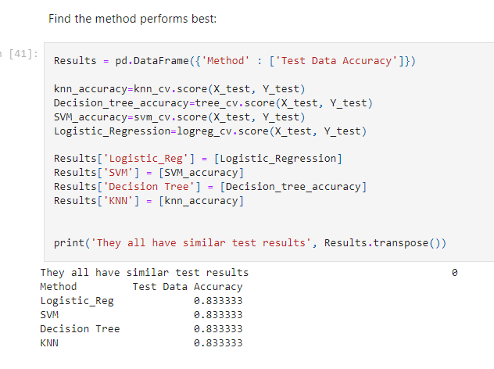
Classification Accuracy
All models performed equally well

Slide 44
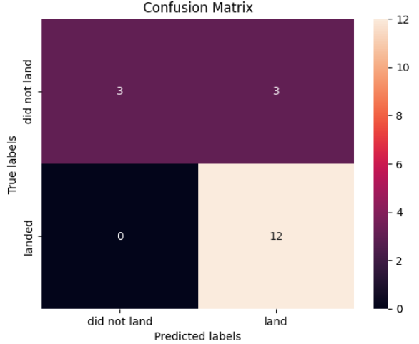
Confusion Matrix
The confusion matrix for the classifiers shows that they can distinguish between the different labels. The major problem is the false positives .i.e., unsuccessful landing marked as successful landing by the classifier.
Confusion matrices can be read as:
Prediction Breakdown:
12 True Positives and 3 True Negatives
3 False Positives and 0 False Negatives

Slide 45
Conclusions
We can conclude that:
Orbits ES-L1, GEO, HEO, SSO, VLEO had the most success rate.
KSC LC-39A had the most successful launches of any sites.
SpaceX does not have a perfect track record of Falcon 9 first stage landing outcomes.
SpaceX’s Falcon 9 first stage landing outcomes have been trending towards greater success since 2013 as more launches are made.
The machine learning models can be used to predict future SpaceX Falcon 9 first stage landing outcomes.
The larger the flight amount at a launch site, the greater the success rate at a launch site.

Slide 46
Appendix
Initial Data Sets
SpaceX API (JSON): https://cf-courses-data.s3.us.cloud-object-storage.appdomain.cloud/IBM-DS0321EN-SkillsNetwork/datasets/API_call_spacex_api.json
Wikipedia (Webpage): https://en.wikipedia.org/w/index.php?title=List_of_Falcon_9_and_Falcon_Heavy_launches&oldid=1027686922
SpaceX (CSV): https://cf-courses-data.s3.us.cloud-object-storage.appdomain.cloud/IBM-DS0321EN-SkillsNetwork/labs/module_2/data/Spacex.csv?utm_medium=Exinfluencer&utm_source=Exinfluencer&utm_content=000026UJ&utm_term=10006555&utm_id=NA-SkillsNetwork-Channel-SkillsNetworkCoursesIBMDS0321ENSkillsNetwork26802033-2022-01-01
Launch Geo (CSV): https://cf-courses-data.s3.us.cloud-object-storage.appdomain.cloud/IBM-DS0321EN-SkillsNetwork/datasets/spacex_launch_geo.csv
Launch Dash (CSV): https://cf-courses-data.s3.us.cloud-object-storage.appdomain.cloud/IBM-DS0321EN-SkillsNetwork/datasets/spacex_launch_dash.csv

Slide 47
Appendix
Jupyter Notebooks and Dashboard Python File
GitHub URL (Data Collection): https://github.com/jamesenet/SpaceX-Falcon-9-first-stage-Landing-Prediction/blob/main/spacex-data-collection-api.ipynb
GitHub URL (Web Scraping): https://github.com/jamesenet/SpaceX-Falcon-9-first-stage-Landing-Prediction/blob/main/SpaceXwebscraping.ipynb
GitHub URL (Data Wrangling): https://github.com/jamesenet/SpaceX-Falcon-9-first-stage-Landing-Prediction/blob/main/spacex-Data%20wrangling.ipynb
GitHub URL (EDA with SQL): https://github.com/jamesenet/SpaceX-Falcon-9-first-stage-Landing-Prediction/blob/main/eda-sql-coursera_sqllite.ipynb
GitHub URL (EDA with Data Visualization): https://https://github.com/jamesenet/SpaceX-Falcon-9-first-stage-Landing-Prediction/blob/main/SpaceX%20Exploratory%20Analysis.ipynb
GitHub URL (Folium Maps): https://github.com/jamesenet/SpaceX-Falcon-9-first-stage-Landing-Prediction/blob/main/SpaceX_launch_site_location.ipynb
GitHub URL (Machine Learning): https://github.com/jamesenet/SpaceX-Falcon-9-first-stage-Landing-Prediction/blob/main/SpaceX_Machine%20Learning%20Prediction_Part_5.ipynb

Slide 48


